Slide 1
Genome-wide association studies
David A. Hughes
d.a.hughes@bristol.ac.uk
MRC Integrative Epidemiology Unit, University of Bristol, UK

Slide 2
Learning objectives
By the end of this lecture you should have
A basic idea of what a genome-wide association study or GWAS is.
Some historical context.
A general idea of how to run a GWAS.

Slide 3
Lecture Outline
Why learn about GWAS in this short course?
Heritability
Historical context
How to conduct a GWAS
Traits to study
Heritability
Data
Quality control (QC) procedures
GWAS software
Interpretation
Downstream analyses or Post-GWAS (Era ?)

Slide 4
Why should I care about GWAS right now?
Mendelian randomization
Directed acyclic graphs (DAGs)​
U
We need instrumental variables
Z
X
Y

Slide 5
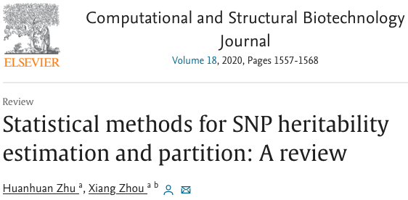
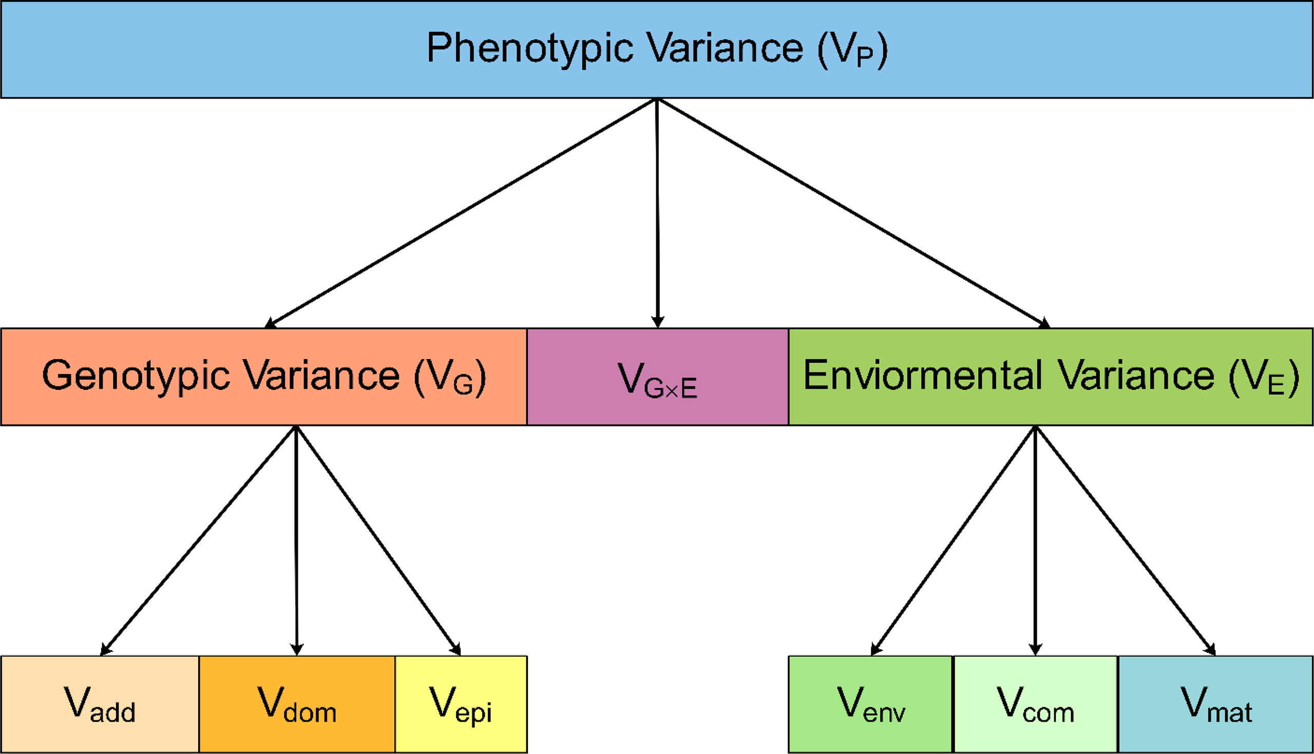
Heritability
Heritability
Proportion of phenotypic variance explained by genetic factors.
Broad sense heritability (H²)
That explained by additive, dominant, and epistatic effects
Narrow sense heritability (h²)
That explained by additive genetic effects
“SNP based heritability”
Notes:
Accurate estimation of heritability can show the degree to which genetic factors influence phenotypes and improve our understanding of the genetic basis of disease and disease-related complex traits . Indeed, heritability plays an important role across a range of genetic applications [1]: it is a key for understanding the evolutionary forces underlying nat- ural selection; it determines how a population will respond to selection; it predicts, at least in part, gene mapping power in genome-wide association studies; it can estimate, quite accurately in some cases, the phenotypic value of an individual and thus facil- itate genomic selection via predicted breeding values; and it pro- vides an upper limit for the genetic prediction of phenotypes.

Slide 6
Heritability
Heritability
Why do we care?
Aids in ascertaining genetic architecture of traits.
Help us predict the power of a GWAS.
Provides an upper limit on genetic prediction of phenotypes
Facilitate genomic selection in breeding programs
Helps understand evolutionary forces underlying natural selection.
Aids in determining how a population will respond to selection.
Notes:
Accurate estimation of heritability can show the degree to which genetic factors influence phenotypes and improve our understanding of the genetic basis of disease and disease-related complex traits . Indeed, heritability plays an important role across a range of genetic applications [1]: it is a key for understanding the evolutionary forces underlying nat- ural selection; it determines how a population will respond to selection; it predicts, at least in part, gene mapping power in genome-wide association studies; it can estimate, quite accurately in some cases, the phenotypic value of an individual and thus facilitate genomic selection via predicted breeding values; and it provides an upper limit for the genetic prediction of phenotypes.

Slide 7
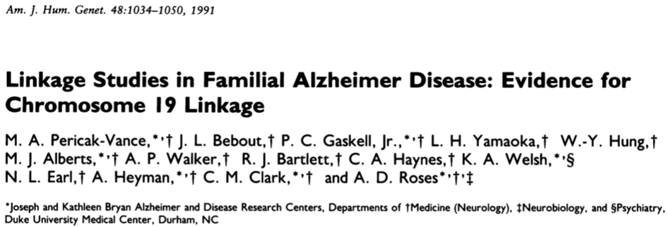
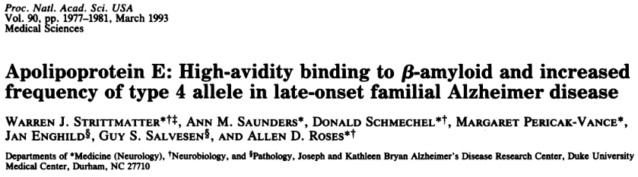
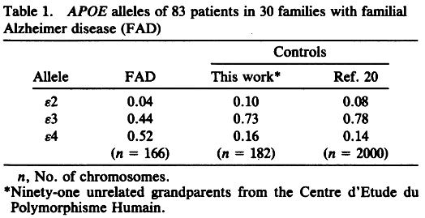
Historical Context
Linkage analyses
Candidate gene studies
Supervised selection b/c of
a priori hypothesis
function
genomic location
Difficulties
small sample sizes
effect sizes / penetrance
trait complexity
gene / locus selection
relaxed association thresholds
replication
30 cases from 30 families; follow up in all 83 cases
91 controls

Slide 8
Historical Context
Genome wide association studies (GWAS)
Interrogation of the entire genome
unsupervised selection of loci
hypothesis free
difficulties
relies upon high genetic marker density >100K
unprecedented level for type I error
stringent association thresholds
replication

Slide 9

GWAS Scope
Understanding
genetic aetiology
biology of disease
the basis of individual differences
Genetic risk prediction
Instruments to understand observational epidemiological associations (MR)
The identification of drug targets and the development of new drugs/drug repositioning

Slide 10

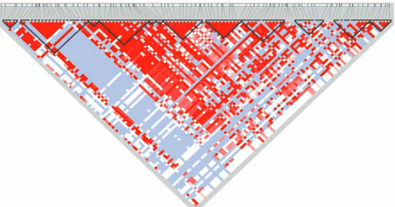
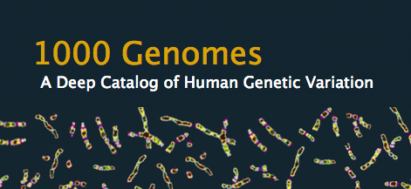
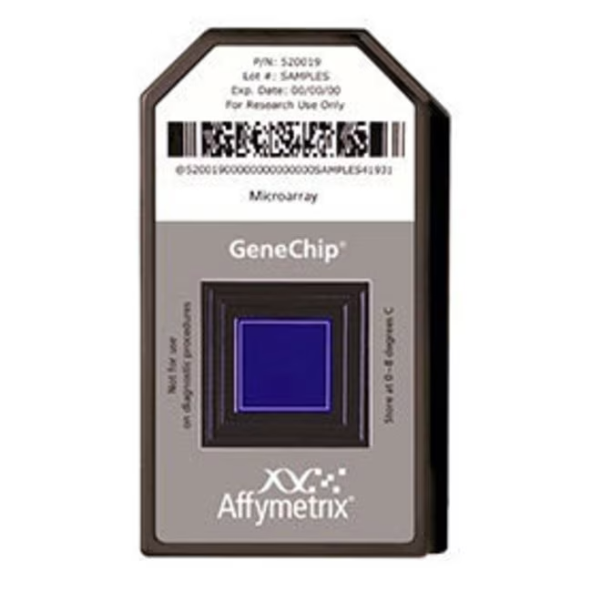
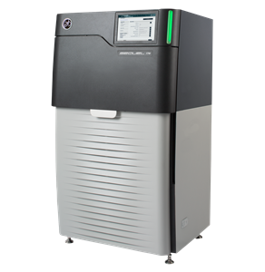
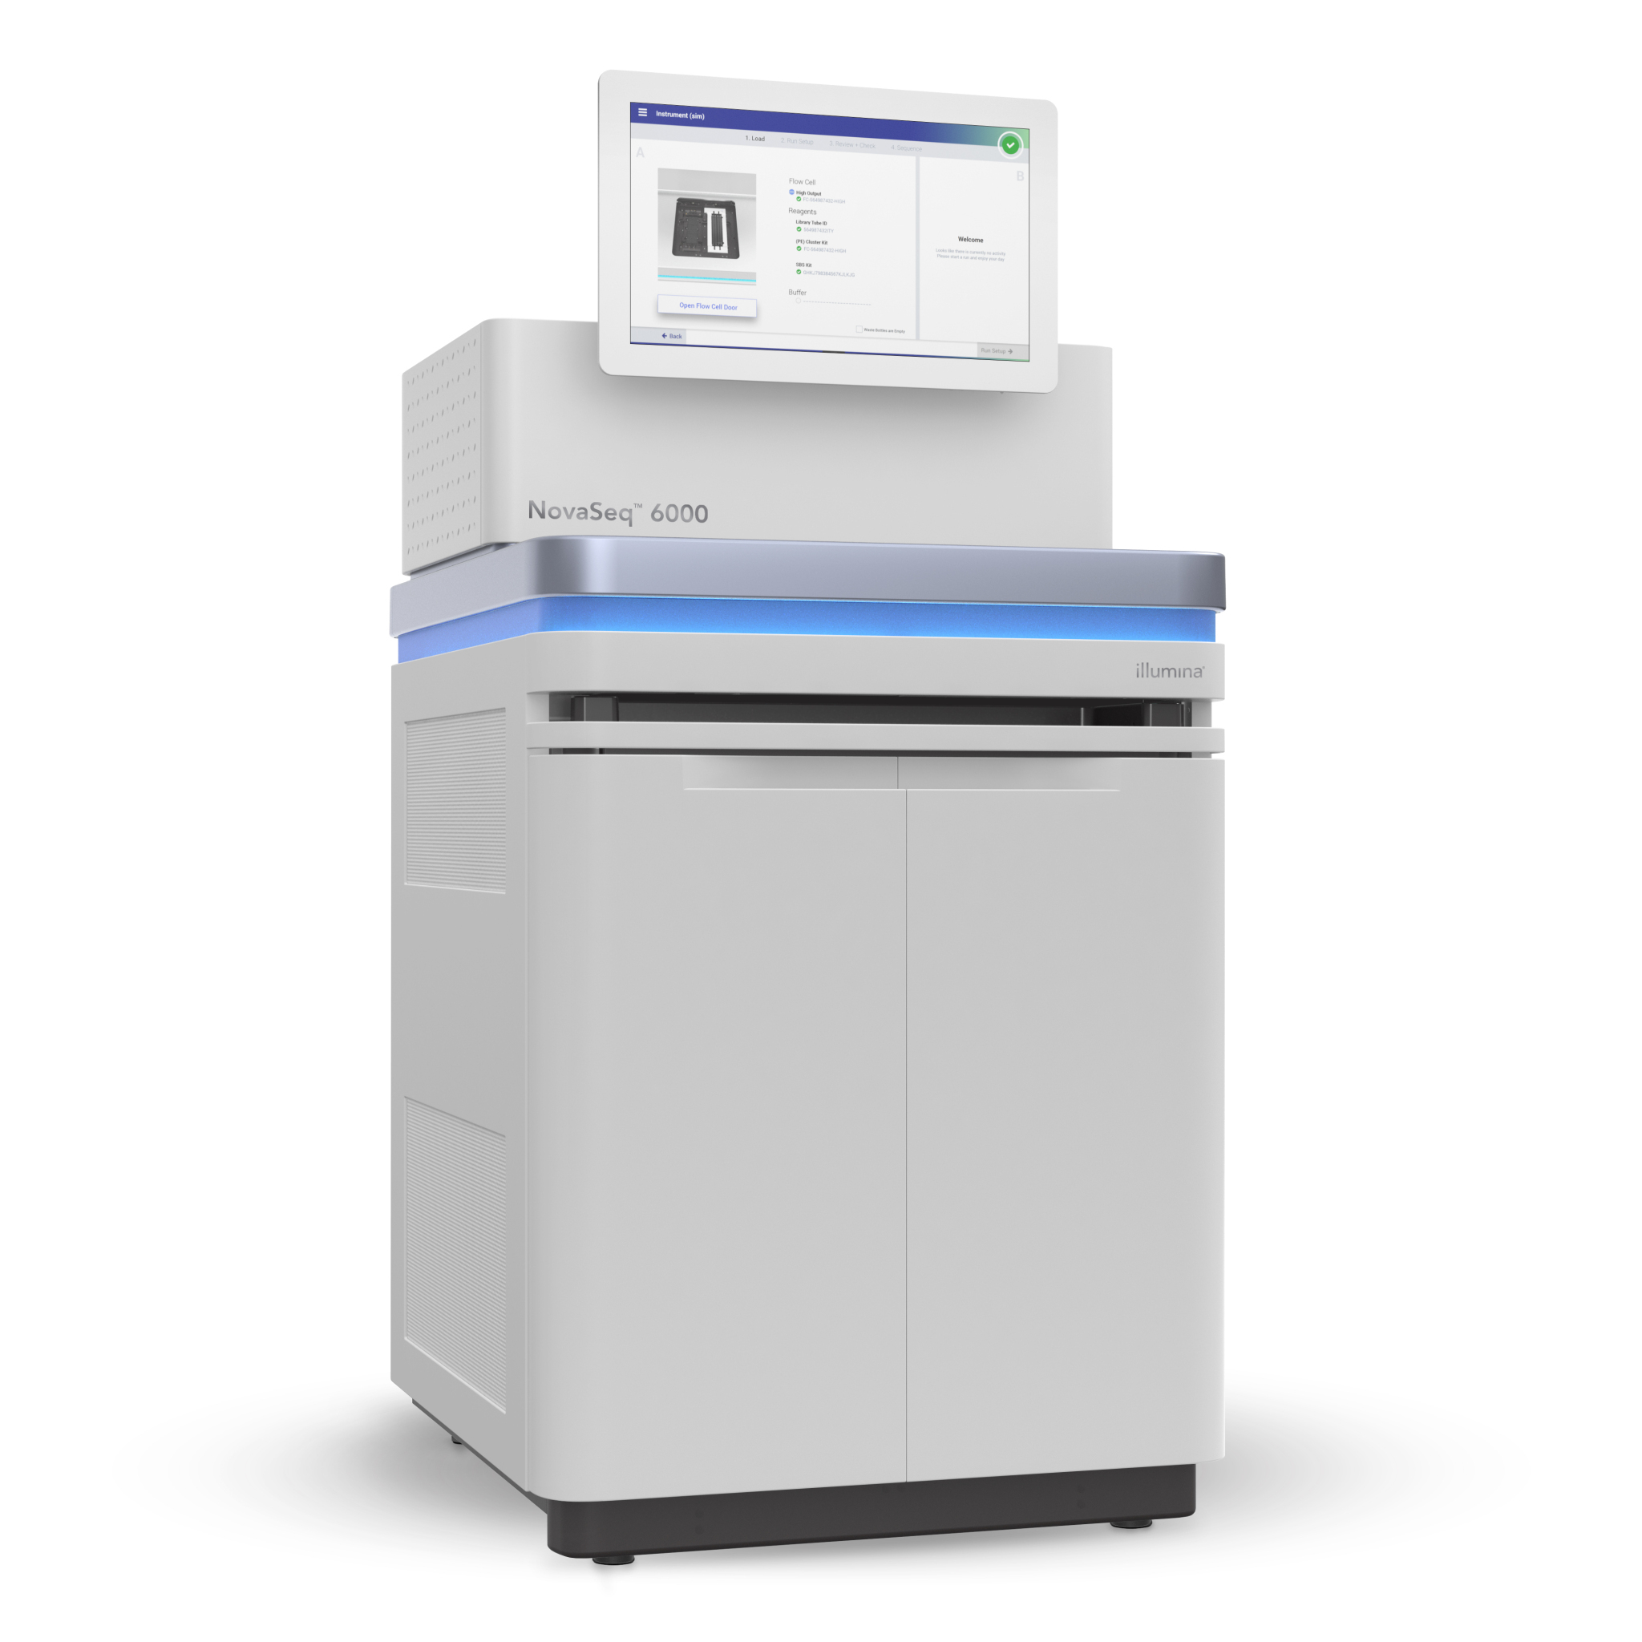
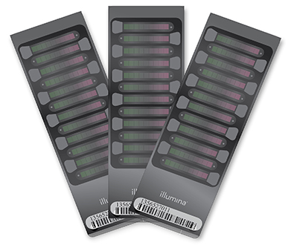
Enabling GWAS
What was / is needed?
a reference genome(s):
a catalog of genetic variation
a map of LD around those variants
Technology
High throughput genotype
genotyping arrays
re-sequencing (WGS or WES)

Slide 11
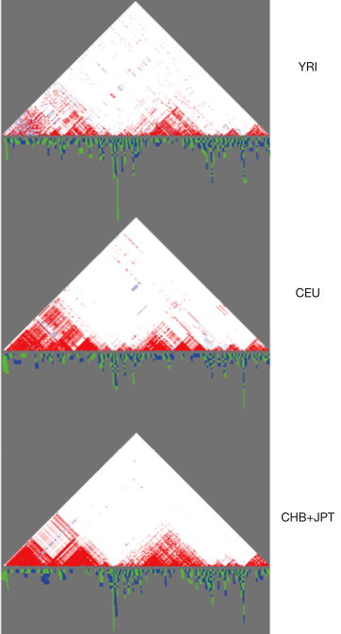
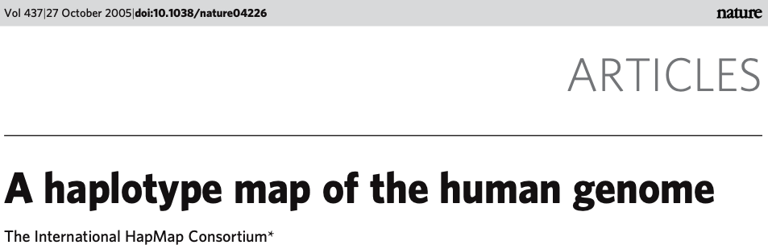
Enabling GWAS cont’d
New haplotype reference panels
Haplotype Map
1000Genomes
Haplotype Reference Consortium
TopMed
UGR

Slide 12
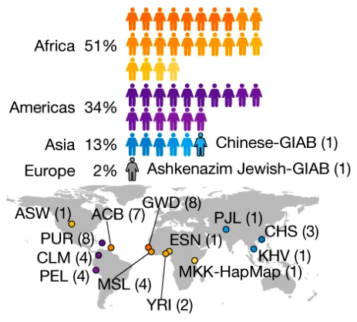


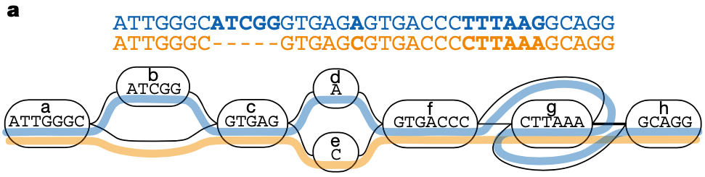
Enabling GWAS cont’d
Human Pangenome Reference Consortium (HPRC)

Slide 13














Enabling GWAS
Large cohorts / consortia
UGR

Slide 14
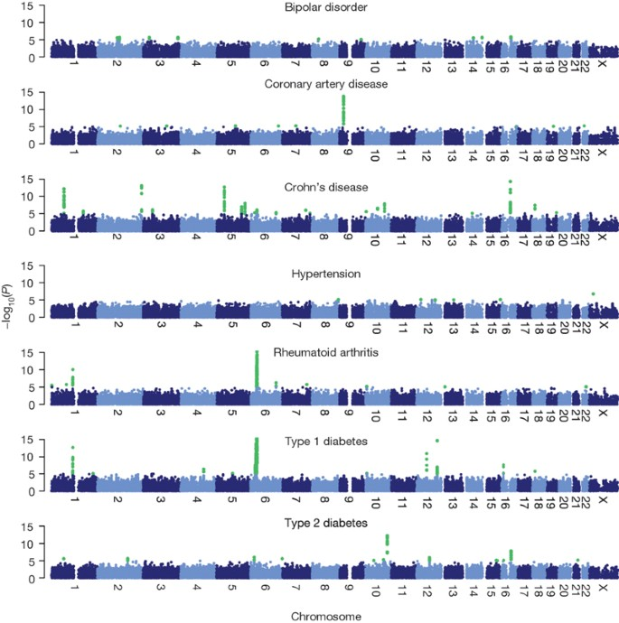
The GWAS era begins: Wellcome Trust Case Control Consortium (2007)
1
1
9
0
3
7
7 diseases
14,000 cases
3,000 shared controls
3

Slide 15
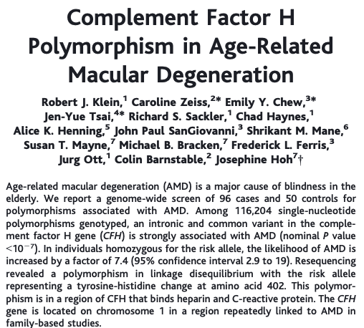
Oldest study in GWAS Catalog
96 cases
50 controls
116,204 SNPs
Affymetrix GeneChip Mapping 100K (2 arrays)
Associations:
rs380390
CFH: complement factor H; P < 10⁻⁷
rs10272438
out of HWE – genotyping error
genotyped by resequencing
association lost

Slide 16

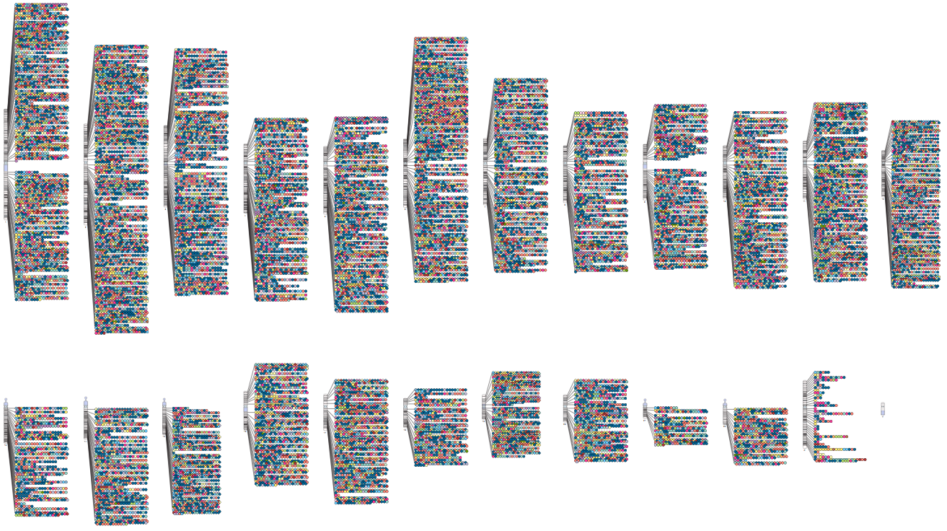
As of June 2023:
81,398 GWAS
6,401 publications

Slide 17
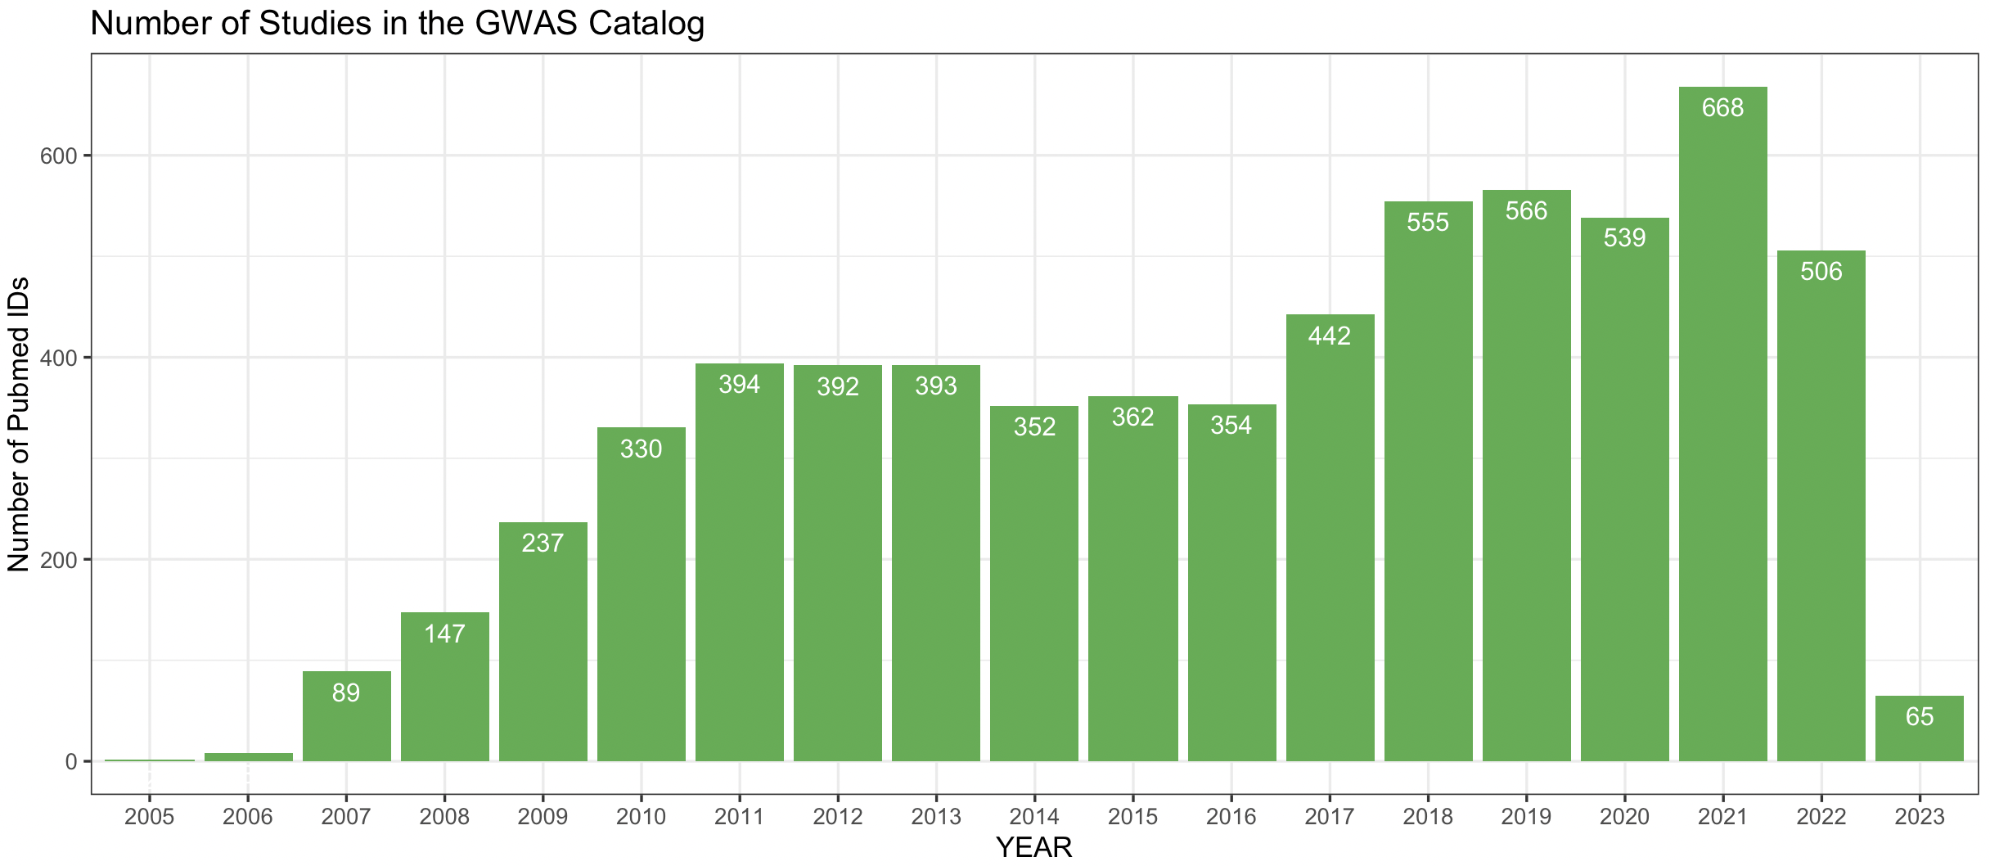
Number of GWAS publications

Slide 18
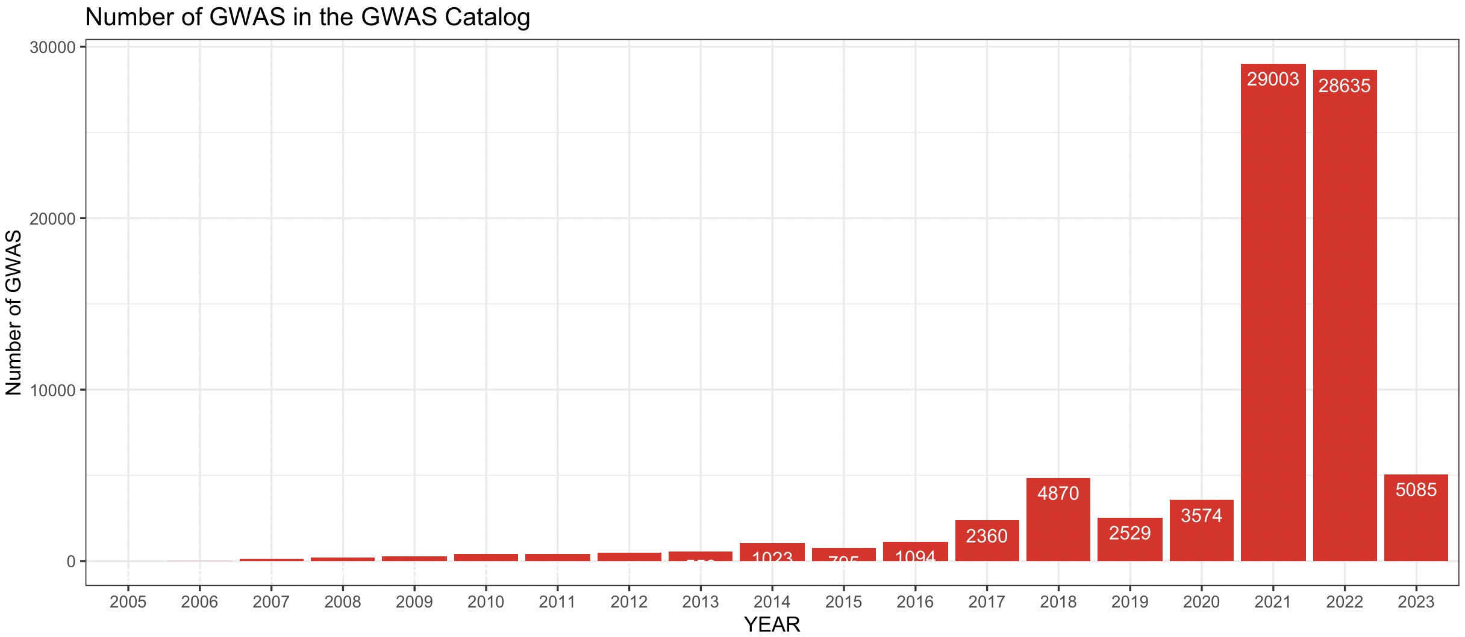
Number of GWAS

Slide 19
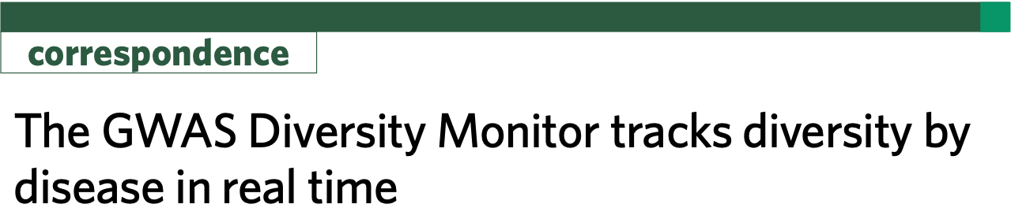
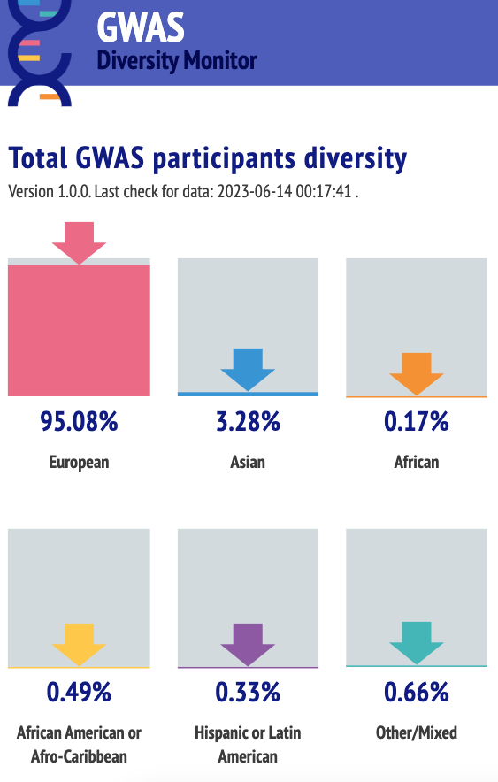
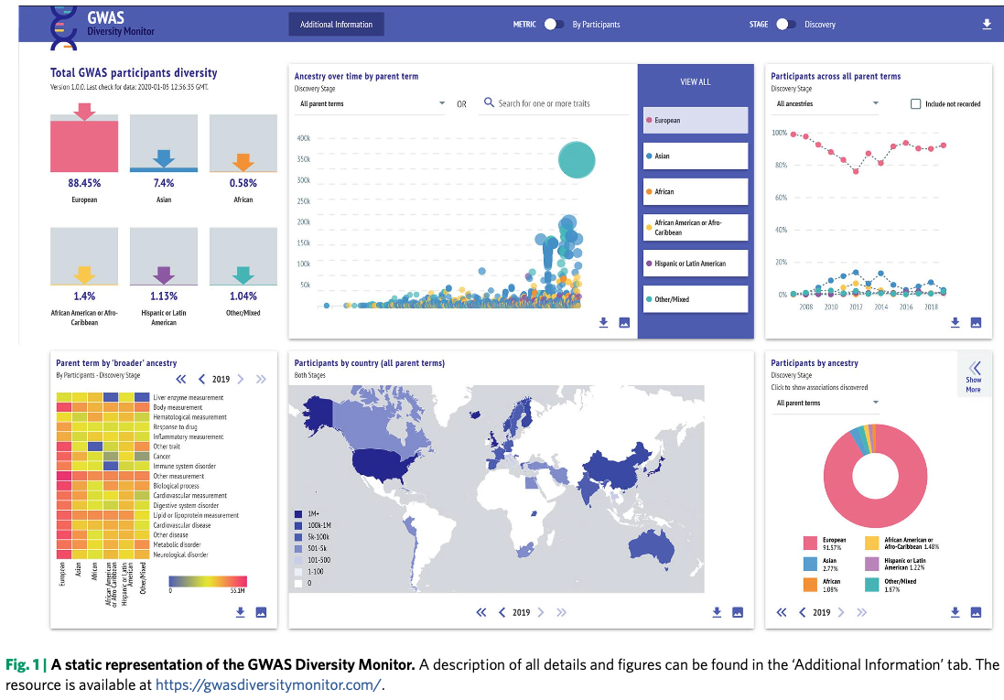

Slide 20
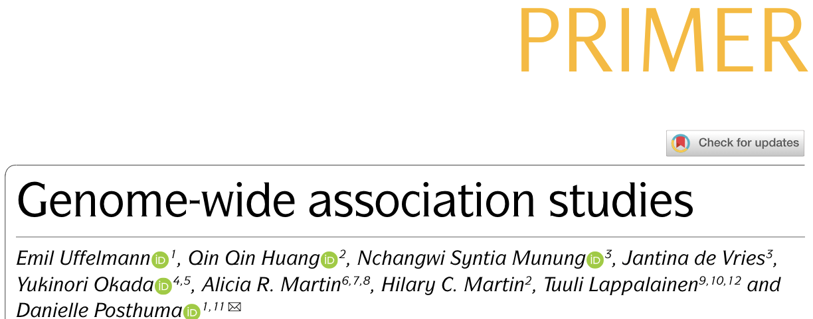
How to run a GWAS

Slide 21
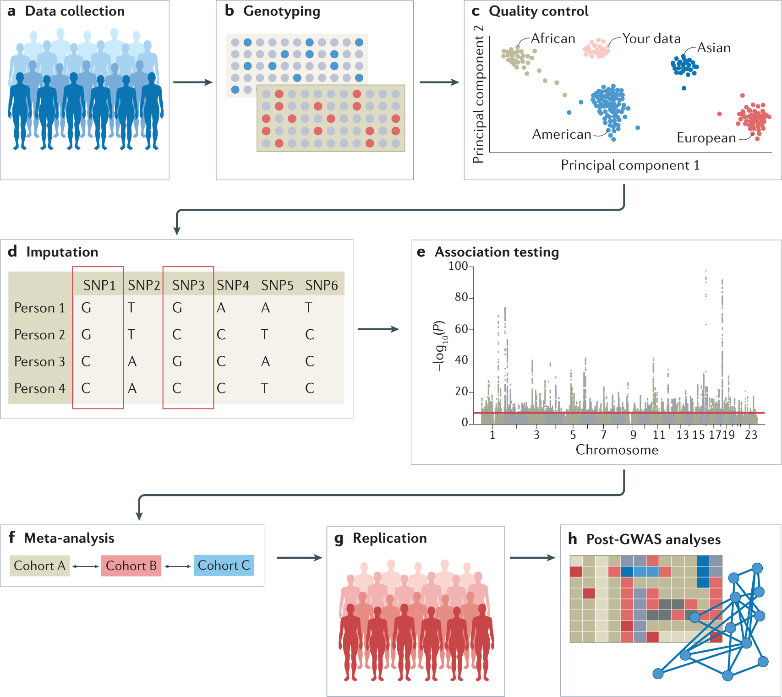
How to run a GWAS
5 essential steps
Sampling
Genotyping
Quality Control
Imputation
Association Analysis
3 highly advocated follow ups
Meta analysis
Replication
Post-GWAS analyses

Slide 22
Sampling
Study design
Case control (disease-focused)
Family-based designs
Population-based designs
Sample size
Power analysis
CaTS: UM Power Calculator GPC: Harvard Power Calculator
Time and Resources
Recruitment strategy
Biases
Not random representation of pop
Sampling / Representation
Collider
Volunteer
Location/Hospital/Disease

Slide 23
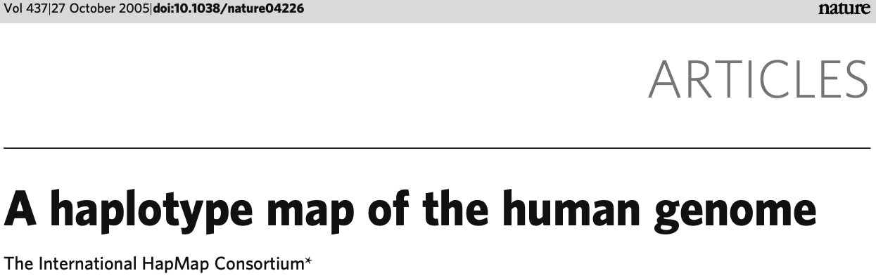
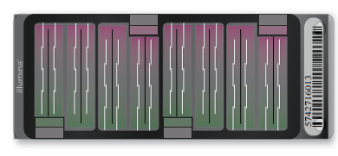
Genotyping
HapMap Consortium deduced that ~500k common SNPs needed to common variation in non-African populations
This value increase
as sample population effect population size (N_{e}) increases and LD decreases
as rare variants are included in the analysis
Newest chips have even higher coverage of markers:
Illumina Omni5 4.3million markers
UGR used the Omni 2.5 with ~2.4 M SNPs.

Slide 24
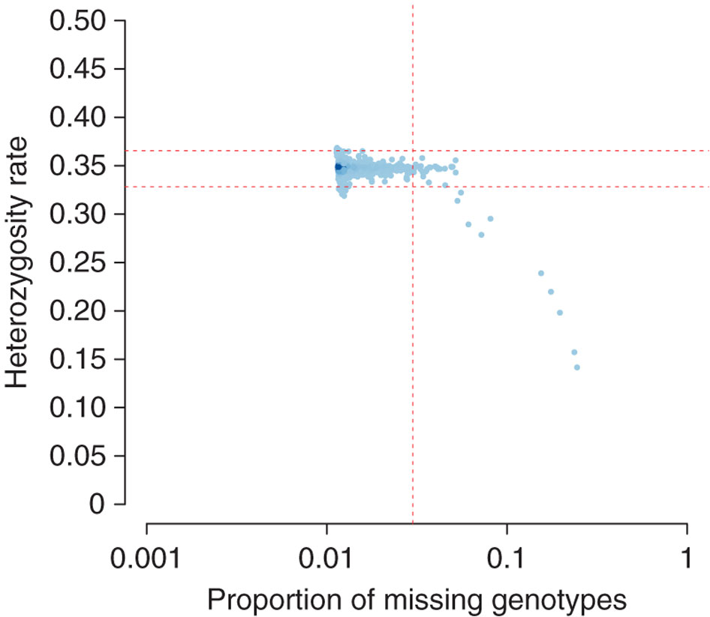
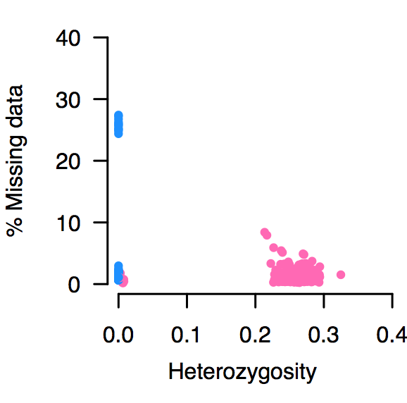
Quality Control
Genotyping array filtring based on
Monomorphic alleles
Hardy-Weinberg equilibrium (HWE)
Missingness (SNPs and Samples)
Heterozygosity
Reported and predicted sex
PCA outliers
error or ancestry
Relatedness

Slide 25
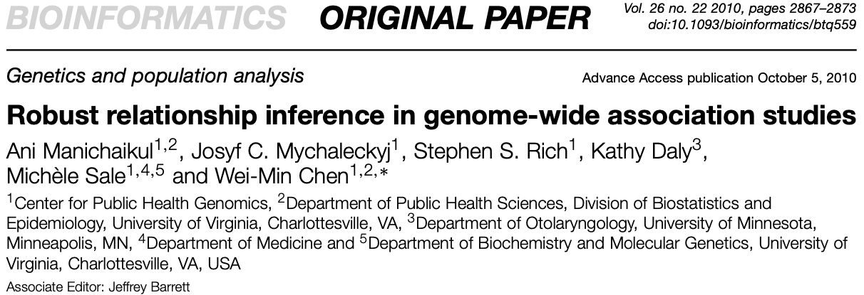
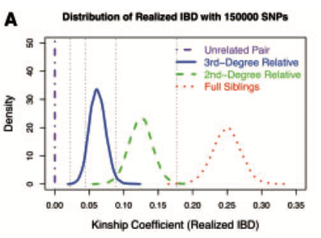
Quality Control - relatedness
KING-robust kinship
Identity by state (IBS)
Identity by descent (IBD)
A/G A/G
A/G A/G
A/G A/G
A/G A/G
IBS = 2
IBD = 0
IBS = 2
IBD = 2

Slide 26
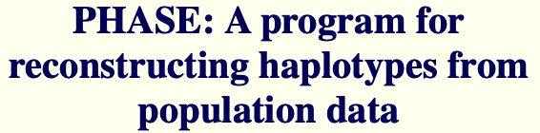
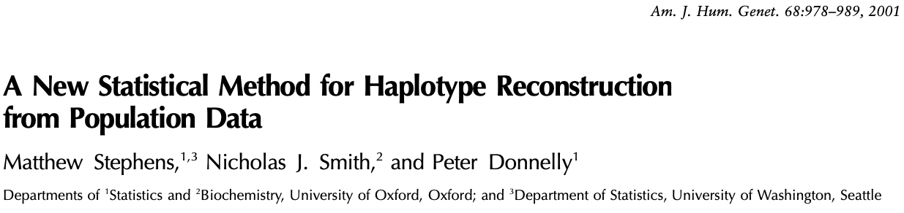
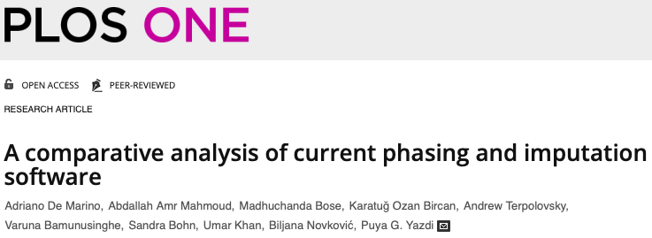
Imputation
Phasing
Haplotype Inference
BEAGLE
EAGLE
MaCH
SHAPEIT
Imputation
Genotype Prediction
BEAGLE
IMPUTE
MINIMAC

Slide 27
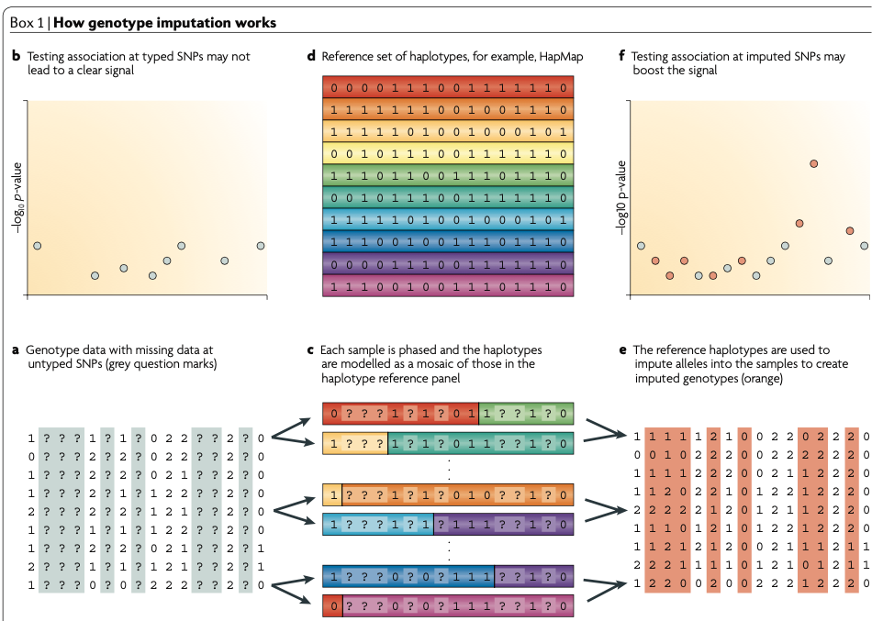
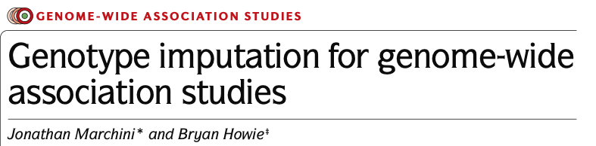
Imputation

Slide 28
Imputation
Imputation provides Genotype Probability Scores
A probability for each genotype
> AA Aa aa
> 0.01 0.1 0.89
Converting to “hard call” or best guess data losses associated error
> aa
Using dosage is a good alternative as it carries the error with it.
> P_{AA} * 0 + P_{Aa} * 1 + P_{aa} * 2 = 1.88

Slide 29
Post imputation quality control
SNP filtering
Minor allele count (MAC)
MAF minor all frequency
Imputation “information”
A quality that ranges from 0 to 1
INFO
R²
Common filter value is <0.3
an information measure of a on a sample of N individuals indicates that the amount of data at the imputed SNP is approximately equivalent to a set of perfectly observed genotype data in a sample size of aN

Slide 30
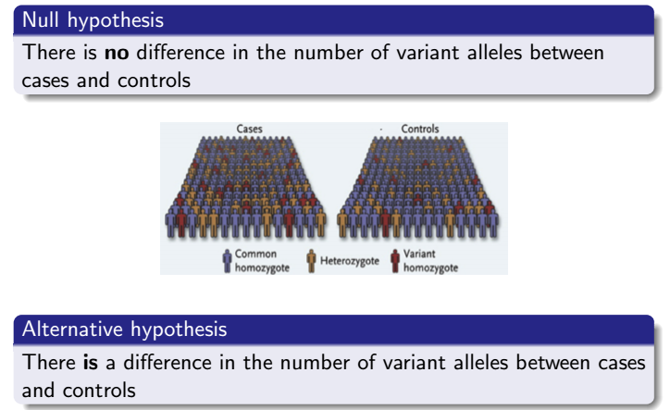
Association Analysis
Statistical Testing
Linear or logistic regression
Assuming an additive genetic model
Repeated for every genetic variant

Slide 31
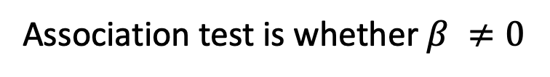
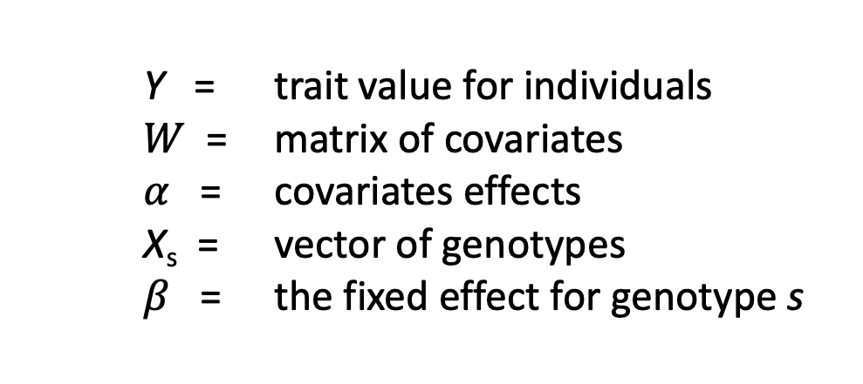
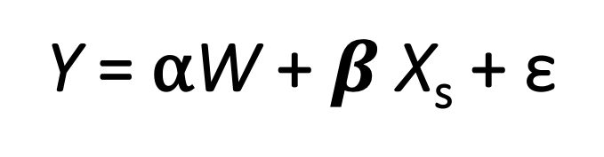
Association Analysis
Continuous trait regression framework
Y = trait value for individuals
$W$ = matrix of covariates
$α$ = covariates effects
X_{s} = vector of genotypes
$β$ = the fixed effect for genotype s
Y = ⍺W + $β$X_{s} + ε
Association test is whether $β ≠0$

Slide 32
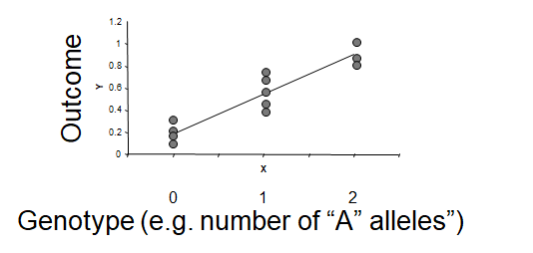
Association Analysis
Additive genetic model

Slide 33
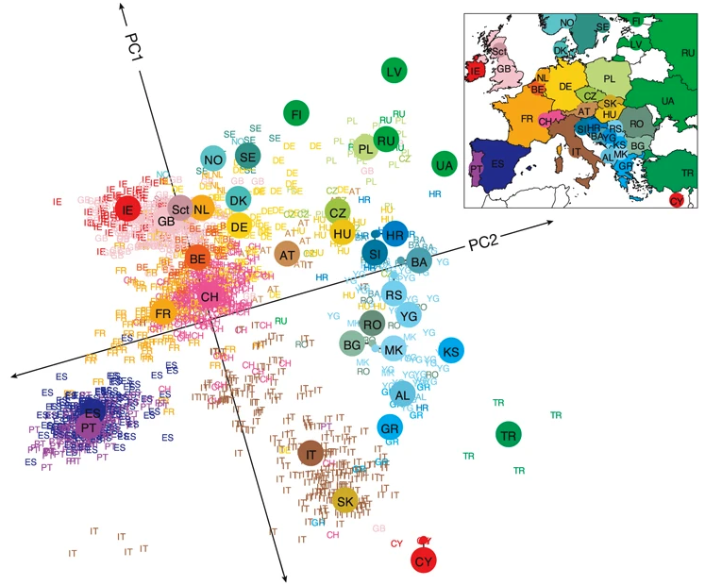
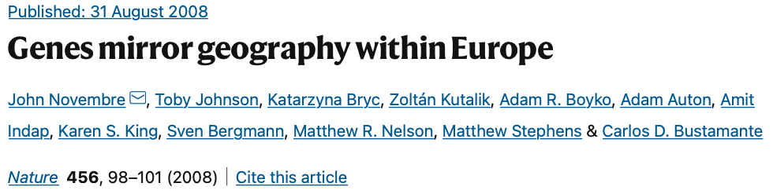
Association Analysis
Careful consideration must be given to
Population Structure*
Kinship / Relatedness*
random effect term
Covariable choice
Sex
Age
Batch
Array
Recruitment center

Slide 34
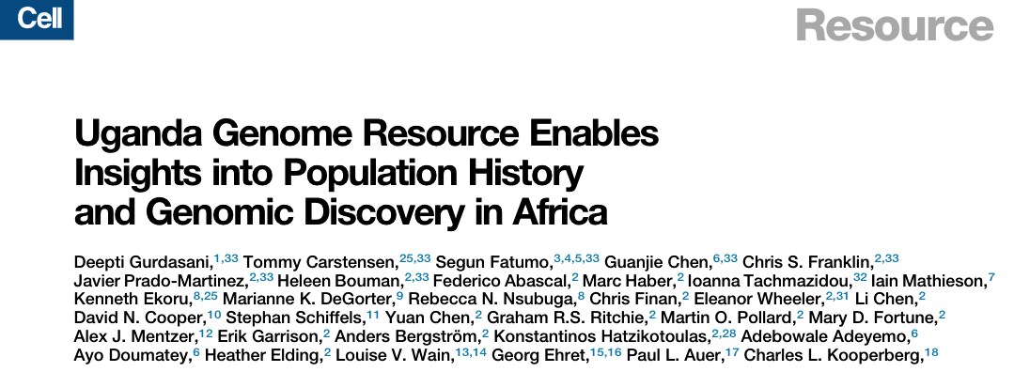
Association Analysis
Multiple test correction for type I error
Given the estimation of 1million independent common variants
Estimated from HapMap data
Bonferroni threshold for an association is commonly set to
0.05/ 1,000,000 = 5 x 10⁻⁸
BF estimation is dependent upon N_{e}, diversity, and population LD
UGR recently estimated a BF of 5 x 10⁻⁹
A variety of methods were used to estimate M_{e} of the effective number of markers.

Slide 35
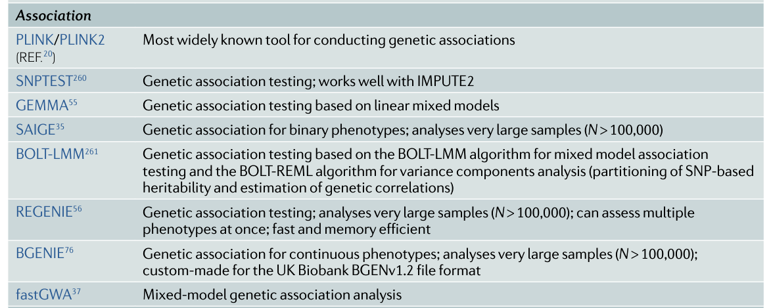
Association Analysis
Software

Slide 36
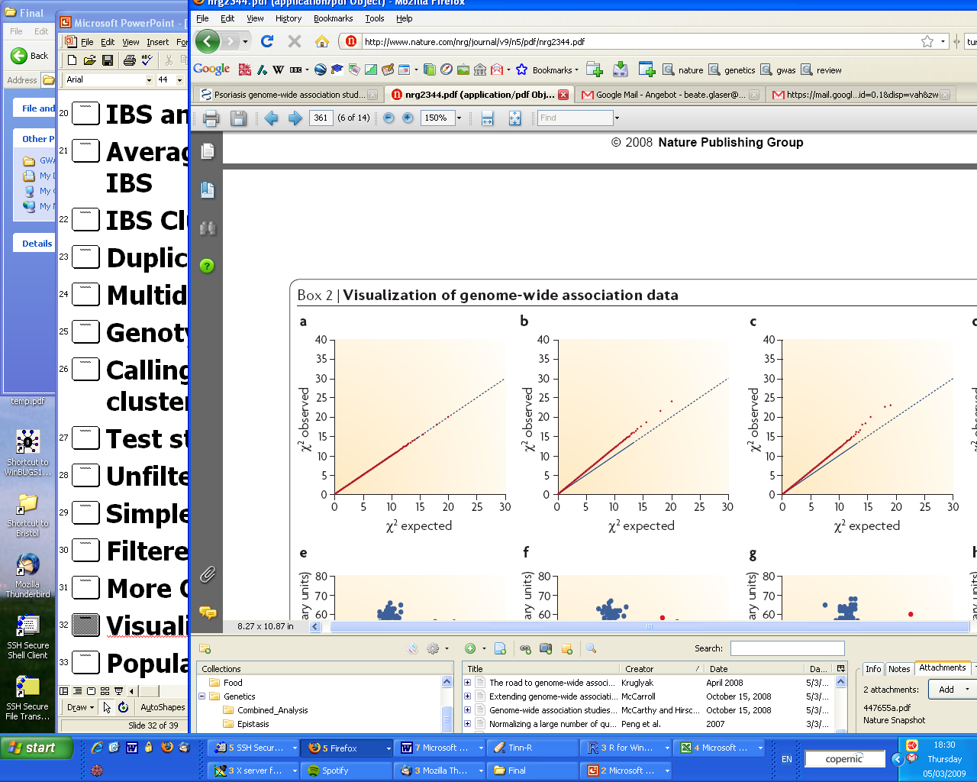
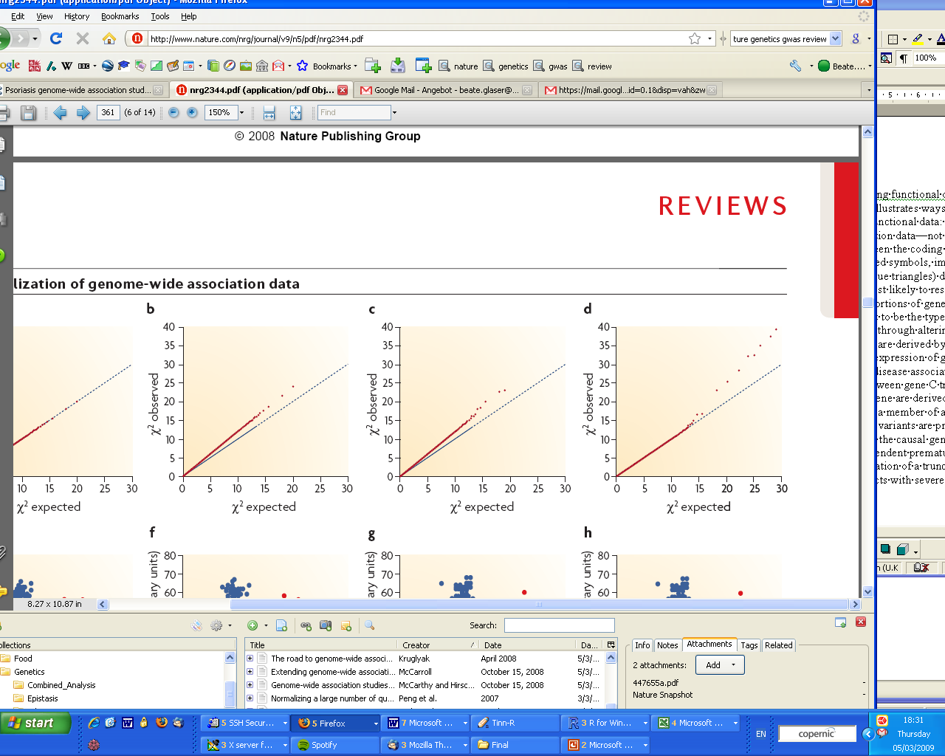
Post GWAS - QQ Plots
Visualisation of minor deviations from the null distribution
No association
Population structure
Population substructure + association
True disease associations
McCarthy et al. (2008) Nature Genetics

Slide 37
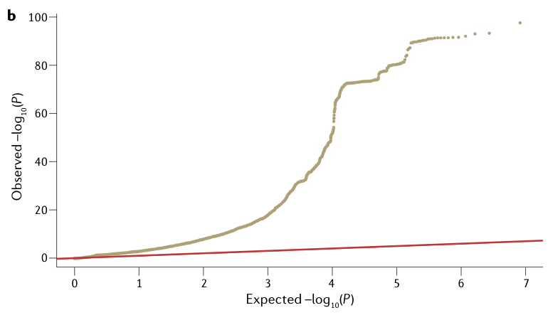
Post GWAS - QQ Plots
BMI GWAS
Power and polygenicity can also lead to inflation
LDSC can help clarify observation

Slide 38
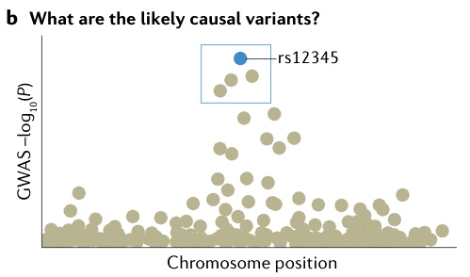
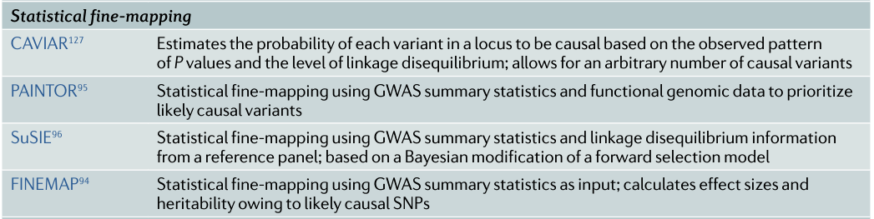
Post GWAS – independent signals
Fine mapping
LD clumping
Conditional association analysis
GCTA-COJO
Bayesian methods

Slide 39

Post GWAS - function
Annotation of variants

Slide 40

Post GWAS - function

Slide 41


Post GWAS - function
Pathways

Slide 42

Post GWAS – REPLICATION !

Slide 43


Frequency and effect – mutation, drift, selection
The power of a GWAS to identify an association depends on the fraction of the trait variation explained by the SNP.
This increases in proportion to the square of the effect size and the heterozygosity.

Slide 44


Benefits & Limitations

Slide 45
Summary
You should now
Know what a GWAS is
Have some historical context behind GWAS
Have a general idea of what it takes to run a GWAS
Know of a few references to follow up for more information on how to conduct a complete GWAS.

Slide 46
Acknowledgements
Mendelian randomization short course leads & tutors​

